Slide 1

Preaching—What to Preach?
Sunday Comes Every Seven Days
Inman 2—May 14, 2013
www.learnhebrewpod.com

Slide 2
Isaiah’s Series of 51 sermons
Proposal: Study the sermon series in Isa 40-55
1 40:1-11 Three voices
2 40:12-31 Three I’s about G
3 41:1-5 Who does these things?
4 41:6-7 how to make an idol
5 41:8-13 Fear not
6 41:14-16 Fear not
7 41:17-20 Rivers of assurance
8 41:21-29 Who does these things?
9 42:1-4 Servant Song
10 42:5-9 Servant
11 42:10-13 new song
12 42:14-17 blind Israel
13 42:18-25 deaf Israel
14 43:1-7 Fear not
15 43:8-15 Who does these things?
16 43:16-21 I am doing a new thing
17 43:22-28 Has Israel been faithful?
18 44:1-5 Fear not
19 44:6-8 Who does these things?
20 44:9-20 how to make an idol
21 44:21-23 Does Israel remember?
22 44:24-45:7 Cyrus
23 45:8 Rain song
24 45:9-13 Potter and pottery
25 45:14-17 God with you
45:18-19 Who does these things?
27 45:20-25 Who does these things?
28 46:1-4 Bearing & Being Borne
29 46:5-7 Who is like me?
30 46:8-13 The good old days
31 47:1-15 Babylon into the dirt
32 48:1-11 Israel is stubborn
33 48:12-17 God will crush Babylon
34 48:18-19 What might have been
35 48:20-22 Go Home
36 49:1-6 Servant Song
37 49:7-12 Go home
38 49:13-26 I will not forget you
39 50:1-3 Bill of Divorce
40 50:4-9 Servant Song
41 50:10-51:8 Fear Not
42 51:9-52:2 Fear Not
43 52:3-6 It’s Not About Money
44 52:7-10 God is King!
45 52:11-12 Depart!
46 52:13-53:12 Servant Song
47 54:1-10 Sing Oh Barren One
48 54:11-17 The New Salvation
49 55:1-5 Come all that Thirst
50 55:6-11 The Word of God
51 55:12-13 Thank God free at last

Slide 3
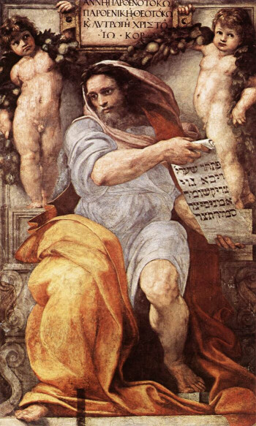
Outline
Isaiah as a whole
World of Isa 40-55
Analysis of 51 sermons in the series
Points from Isaiah
The prophet Isaiah by Raphael
www.finearttouch.com

Slide 4
Outline of all Isaiah
1-12 Oppression/judgment/hope
13-23 Oracles against the nations
24-27 World apocalyptic
28-33 Woes (6)
34-35 Herem/Homecoming
36-39 Hezekiah
40-55 God of hope & history sends a servant
56-66 God high & holy sends a preacher

Slide 5
Isaiah writes
to three different audiences
  1-39—8th century B.C. Jerusalem
  40-55—6th century B.C.
    People from Jerusalem in Babylonian Captivity
    Controversy over divisions of text
  56-66—5th century B.C.
    post-exilic Jerusalem

Slide 6
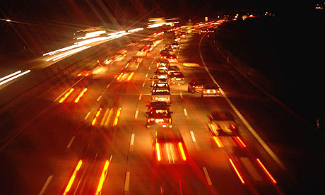
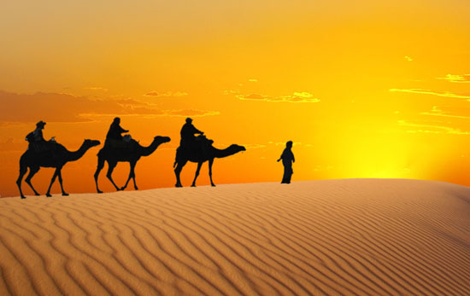
Similarities between Isaiah’s times and our world
www.guardian.co.uk
www.goworldtravel.com
Rootlessness
Fear
Questioning of God
Weak, Defeated
Attracted to new culture
Assimilation
  Become part of culture
Exhaustion
  Give up
  Live in past hope
Recast faith

Slide 7
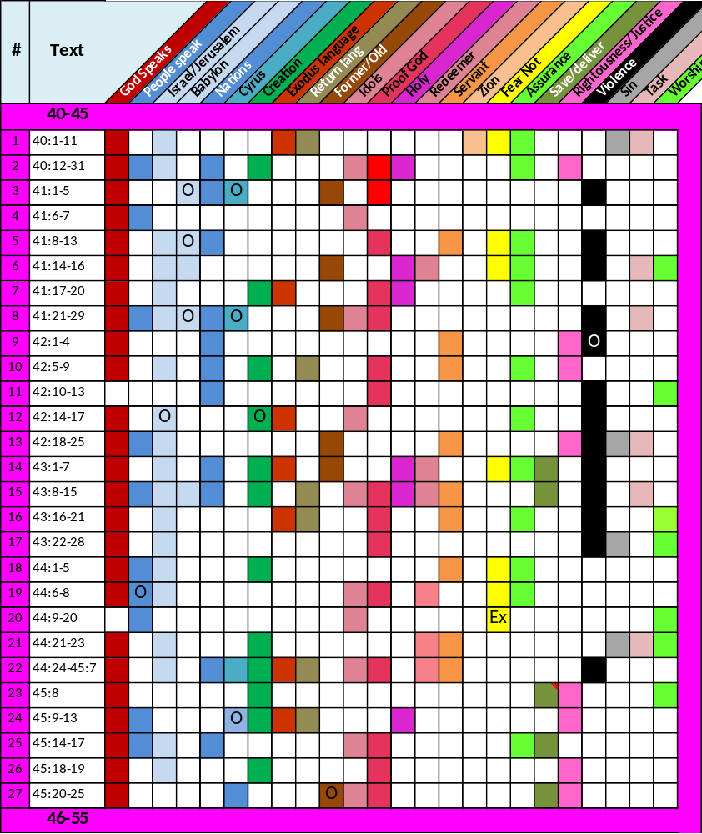
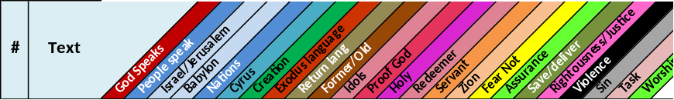
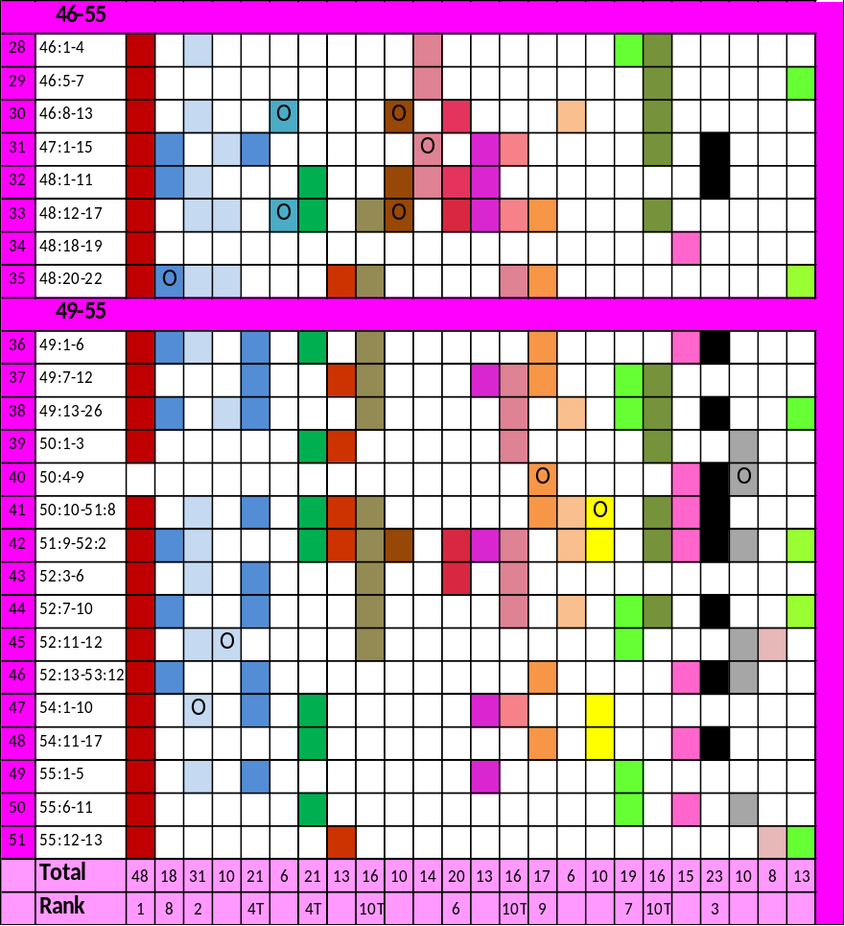
Marks in Color

Slide 8
Dominant Marks
Mark | Rank | Included/total pericopes | Percent
God speaks | 1 | 48 of 51 | 94%
Israel/Jerusalem | 2 | 31 of 51 | 61%
Violence | 3 | 23 of 51 | 45%
Creation | 4 | 21 of 51 | 41%
Nations | 4 | 21 of 51 | 41%
Proof of God | 6 | 20 of 51 | 39%
Assurance | 7 | 19 of 51 | 37%
People speak | 8 | 18 of 51 | 35%
Servant | 9 | 17 of 51 | 33%
Return home | 10 | 16 of 51 | 31%
Idols | 10 | 16 of 51 | 31%
Save/Redeem | 10 | 16 of 51 | 31%

Slide 9
Prophet
Speaks Word of God
Speaks to Israel Jerusalem
Lives in violent world
Uses theology of creation
Israel/God vis-à-vis nations
Apology for God
Cites the people
Stresses service
Home language
Addresses idolatry issue
Stresses salvation
Other Observations?
Mark | Rank
God speaks | 1
Israel/Jerusalem | 2
Violence | 3
Creation | 4
Nations | 4
Proof of God | 6
Assurance | 7
People speak | 8
Servant | 9
Return home | 10
Idols | 10
Save/Redeem | 10

Slide 10
Outline
Isaiah as a whole
Context of Isa 40-55
Analysis of 51 sermons in the series
Points from Isaiah
  General
  Creation
  Proof of God
  Servant
  Salvation
The prophet Isaiah by Raphael
www.finearttouch.com

Slide 11
Isaiah Knew His Audience
“To be a minister in the community is to be a resident, a citizen, a responsible leader, and one who shares both the blame and the credit for the quality of life in that place.” Fred Craddock, Preaching, p. 95.
The prophet Isaiah by Raphael
www.finearttouch.com

Slide 12
Isaiah Knew His Audience
Isaiah identified the major concerns of his audience
Isaiah rotated material to deal with these issues.
The prophet Isaiah by Raphael
www.finearttouch.com

Slide 13
Isaiah’s sermons were linked
“One part is anticipated by the next and the listener is gratified by the sequence.” Fred Craddock, Preaching, p.
The prophet Isaiah by Raphael
www.finearttouch.com

Slide 14
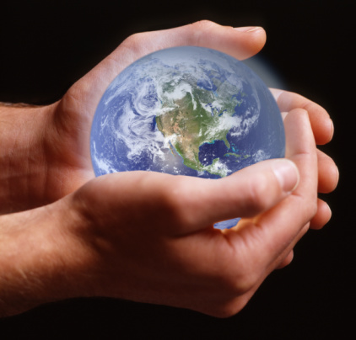
Creation in Isaiah
Text | Titles of Isaiah's Sermons | Creation
40:12-31 | Three I’s about G
41:17-20 | Rivers of assurance
42:5-9 | Servant
42:14-17 | blind Israel | O
43:1-7 | Fear not
43:8-15 | Who does these things?
44:1-5 | Fear not
44:21-23 | Does Israel remember?
44:24-45:7 | Cyrus
45:8 | Rain song
45:9-13 | Potter and pottery illustration
45:18-19 | Who does these things?
48:1-11 | Israel is stubborn
48:12-17 | God will crush Babylon
49:1-6 | Servant Song #2
50:1-3 | Bill of Divorce
50:10-51:8 | Fear Not
51:9-52:2 | Fear Not
54:1-10 | Sing Oh Barren One
54:11-17 | The New Salvation: Fear not
55:6-11 | The Word of God
adoptingjames.wordpress.com

Slide 15
Creation in Isaiah
41: ¹⁷ When the poor and needy seek water, and there is none, and their tongue is parched with thirst, I the LORD will answer them, I the God of Israel will not forsake them. ¹⁸ I will open rivers on the bare heights, and fountains in the midst of the valleys; I will make the wilderness a pool of water, and the dry land springs of water. ¹⁹ I will put in the wilderness the cedar, the acacia, the myrtle, and the olive; I will set in the desert the cypress, the plane and the pine together; ²⁰ that men may see and know, may consider and understand together, that the hand of the LORD has done this, the Holy One of Israel has created it.
adoptingjames.wordpress.com

Slide 16
Creation in Isaiah
41: ¹⁷ When the poor and needy seek water, and there is none, and their tongue is parched with thirst, I the LORD will answer them, I the God of Israel will not forsake them. ¹⁸ I will open rivers on the bare heights, and fountains in the midst of the valleys; I will make the wilderness a pool of water, and the dry land springs of water. ¹⁹ I will put in the wilderness the cedar, the acacia, the myrtle, and the olive; I will set in the desert the cypress, the plane and the pine together; ²⁰ that men may see and know, may consider and understand together, that the hand of the LORD has done this, the Holy One of Israel has created it.
adoptingjames.wordpress.com

Slide 17
Creation in Isaiah
45: 18 For thus says the LORD, who created the heavens (he is God!), who formed the earth and made it (he established it; he did not create it a chaos, he formed it to be inhabited!): "I am the LORD, and there is no other. 19 I did not speak in secret, in a land of darkness; I did not say to the offspring of Jacob, `Seek me in chaos.' I the LORD speak the truth, I declare what is right.
adoptingjames.wordpress.com

Slide 18
Creation in Isaiah
48:13 My hand laid the foundation of the earth, and my right hand spread out the heavens; when I call to them, they stand forth together. 14 "Assemble, all of you, and hear! Who among them has declared these things? 16 Draw near to me, hear this: from the beginning I have not spoken in secret, from the time it came to be I have been there."
adoptingjames.wordpress.com

Slide 19
Creation in Isaiah
God is separate from the created world
God is intimately linked to the world
God created a world that lovingly sustained life
God’s creative role calls for obedience from his creatures
God is not subject to the current political power
God is above whatever local deity
Creation prompts worship
Creation shows the reality of God
adoptingjames.wordpress.com

Slide 20
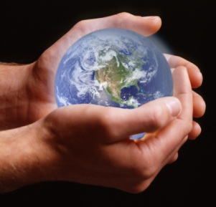
Creation in Isaiah
God is separate from the created world
God is intimately linked to the world
God created a world that lovingly sustained life
God’s creative role calls for obedience from his creatures
God is not subject to the current political power
God is above whatever local deity
Creation prompts worship
Creation shows the reality of God
adoptingjames.wordpress.com
Issues of audience addressed
Creation used in evidential way
Isaiah counters popular culture rhetoric about Babylonian theology & politics
Creation used to show God cares

Slide 21
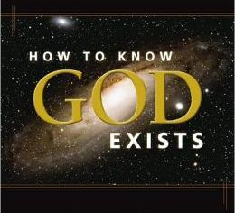
Proof of God
texts
in Isaiah
Text | Titles of Isaiah's Sermons | Proof God
40:12-31 | Three I’s about G
41:1-5 | Who does these things?
41:8-13 | Fear not
41:17-20 | Rivers of assurance
41:21-29 | Who does these things?
42:5-9 | Servant
42:10-13 | new song
43:8-15 | Who does these things?
43:16-21 | I am doing a new thing
43:22-28 | Has Israel been faithful?
44:6-8 | Who does these things?
44:24-45:7 | Cyrus
45:14-17 | God with you
45:18-19 | Who does these things?
45:20-25 | Who does these things?
46:8-13 | Remember the good old days
48:1-11 | Israel is stubborn
48:12-17 | God will crush Babylon
51:9-52:2 | Fear Not
52:3-6 | It’s Not About Money
Barnes and Noble

Slide 22
Proof of God in Isaiah
Based on History
Barnes and Noble
Isaiah 41: 21 Set forth your case, says the LORD; bring your proofs, says the King of Jacob. 22 Let them bring them, and tell us what is to happen. Tell us the former things, what they are, that we may consider them, that we may know their outcome; or declare to us the things to come. 23 Tell us what is to come hereafter, that we may know that you are gods; do good, or do harm, that we may be dismayed and terrified. 24 Behold, you are nothing, and your work is naught; an abomination is he who chooses you. 25 I stirred up one from the north, and he has come, from the rising of the sun, and he shall call on my name; he shall trample on rulers as on mortar, as the potter treads clay. 26 Who declared it from the beginning, that we might know, and beforetime, that we might say, "He is right"? There was none who declared it, none who proclaimed, none who heard your words. 27 I first have declared it to Zion, and I give to Jerusalem a herald of good tidings. 28 But when I look there is no one; among these there is no counselor who, when I ask, gives an answer. 29 Behold, they are all a delusion; their works are nothing; their molten images are empty wind.

Slide 23
Proof of God in Isaiah
43:8 Bring forth the people who are blind, yet have eyes, who are deaf, yet have ears! 9 Let all the nations gather together, and let the peoples assemble. Who among them can declare this, and show us the former things? Let them bring their witnesses to justify them, and let them hear and say, It is true. 10 "You are my witnesses," says the LORD, "and my servant whom I have chosen, that you may know and believe me and understand that I am He. Before me no god was formed, nor shall there be any after me. 11 I, I am the LORD, and besides me there is no savior.
Barnes and Noble

Slide 24
Proof of God in Isaiah
46:8 "Remember this and consider, recall it to mind, you transgressors, 9 remember the former things of old; for I am God, and there is no other; I am God, and there is none like me, 10 declaring the end from the beginning and from ancient times things not yet done, saying, `My counsel shall stand, and I will accomplish all my purpose,' 11 calling a bird of prey from the east, the man of my counsel from a far country. I have spoken, and I will bring it to pass; I have purposed, and I will do it.
Barnes and Noble
Former things
Accomplish my purpose
I will bring to pass

Slide 25
Proof of God in Isaiah
Rolling History in Isaiah
  Prophet predicts & writes
  Event happens
  God’s word is verified
People were witnesses to what God had done
Idols/culture could not duplicate
Barnes and Noble

Slide 26
Proof of God in Isaiah
Rolling History in Isaiah
  Prophet predicts & writes
  Event happens
  God’s word is verified
People were witnesses to what God had done
Idols/culture could not duplicate
Barnes and Noble
Addresses Issues of Audience
Counters questions about God
Assurance that God is powerful enough to deal with issues, he can take them home
Argument against as assimilation or despair

Slide 27
Proof of God in Isaiah
Isaiah may have one of the most in-depth treatments of deity in the entire Bible
  Nature of God
  Power of God
  Concern of God
Barnes and Noble
49:14 But Zion said, "The LORD has forsaken me, my Lord has forgotten me." 15 "Can a woman forget her sucking child, that she should have no compassion on the son of her womb? Even these may forget, yet I will not forget you.”

Slide 28
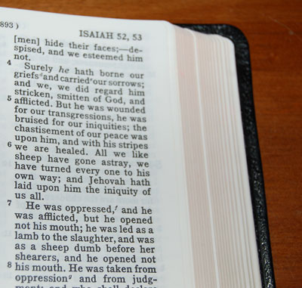
Servant in Isaiah
Text | Titles of Isaiah's Sermons | Servant
41:8-13 | Fear not
42:1-4 | Servant Song #1
42:5-9 | Servant
42:18-25 | deaf Israel
43:8-15 | Who does these things?
43:16-21 | I am doing a new thing
44:1-5 | Fear not
44:21-23 | Does Israel remember?
44:24-45:7 | Cyrus
48:12-17 | God will crush Babylon
48:20-22 | Go Home
49:1-6 | Servant Song #2
49:7-12 | Servant to bring people home
50:4-9 | Servant Song #3 | O
50:10-51:8 | Fear Not
52:13-53:12 | Servant Song #4
54:11-17 | The New Salvation: Fear not

Slide 29
Servant in Isaiah
41: ⁸ But you, Israel, my servant, Jacob, whom I have chosen, the offspring of Abraham, my friend

Slide 30
Servant in Isaiah
42:1 Behold my servant, whom I uphold, my chosen, in whom my soul delights; I have put my Spirit upon him, he will bring forth justice to the nations. 2 He will not cry or lift up his voice, or make it heard in the street; 3 a bruised reed he will not break, and a dimly burning wick he will not quench; he will faithfully bring forth justice. 4 He will not fail or be discouraged till he has established justice in the earth; and the coastlands wait for his law.

Slide 31
Servant in Isaiah
48:16 Draw near to me, hear this: from the beginning I have not spoken in secret, from the time it came to be I have been there." And now the Lord GOD has sent me and his Spirit.
20 Go forth from Babylon, flee from Chaldea, declare this with a shout of joy, proclaim it, send it forth to the end of the earth; say, "The LORD has redeemed his servant Jacob!"

Slide 32
Servant in Isaiah
49:6 he says: "It is too light a thing that you should be my servant to raise up the tribes of Jacob and to restore the preserved of Israel; I will give you as a light to the nations, that my salvation may reach to the end of the earth."

Slide 33
Servant in Isaiah
53:3 He was despised and rejected by men; a man of sorrows, and acquainted with grief; and as one from whom men hide their faces he was despised, and we esteemed him not. 4 Surely he has borne our griefs and carried our sorrows; yet we esteemed him stricken, smitten by God, and afflicted.

Slide 34
Servant in Isaiah
Prophet
Sets foundation for biblical theology of service
Service held up a means of operating in hostile culture
Servant leader
Servant suffers

Slide 35
Servant in Isaiah
Prophet
Sets foundation for biblical theology of service
Service held up a means of operating in hostile culture
Servant leader
Servant suffers
Addresses issues of audience
Service at core of recasting their faith as opposed to assimilation or despair
Service is response to oppressive culture
Service response to state powers
Service gives weak & vulnerable way forward

Slide 36
Servant in Isaiah
Isaiah points to service as a response to a hostile culture
1 Peter 5:6 Humble yourselves therefore under the mighty hand of God, that in due time he may exalt you.
Peter: Humility of resident aliens

Slide 37
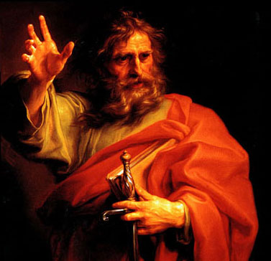
Salvation in Isaiah
Text | Titles of Isaiah's Sermons | Redeemer | Save/deliver
41:14-16 | Fear not
44:21-23 | Does Israel remember?
44:24-45:7 | Cyrus
45:8 | Rain song
45:14-17 | God with you
45:20-25 | Who does these things?
46:1-4 | Idols—Bearing and Being Borne
46:5-7 | Who is like me?
46:8-13 | Remember the good old days
47:1-15 | Mocking song: Babylon to dirt
48:12-17 | God will crush Babylon
48:20-22 | Go Home
49:7-12 | Servant to bring people home
49:13-26 | I will not forget you
50:1-3 | Bill of Divorce
50:10-51:8 | Fear Not
51:9-52:2 | Fear Not
52:3-6 | It’s Not About Money
52:7-10 | Good News: Your God is King!
54:1-10 | Sing Oh Barren One
theolotech.files.wordpress.com
Notes:
Forgiveness
40:2 Speak tenderly to Jerusalem, and cry to her that her warfare is ended, that her iniquity is pardoned, that she has received from the LORD's hand double for all her sins.
42:18-25—God addresses Israel’s sin
43:22-28—God addresses Israel’s sin. Sins that led to BC are forgiven in 40;1-2; sins of BC are under consideration here.
44:22: God has forgiven them, sins are a like a mist, calls them to return to me.
48:1-11—God now sees that their sins are permanent and deep. He forgives those sins: 48:9a: for my name’s sake I defer my anger…I may not cut you off.
53—reason God will forgive. God realizes that there must be some other basis for forgiving sin than the obedience and return of the people.
God makes a covenant—55:3 Incline your ear, and come to me; hear, that your soul may live; and I will make with you an everlasting covenant, my steadfast, sure love for David.
55:7
Harsh sections are about sin 42:18-25; 43:22-28; 48:1-11 (Israel is not honest)

Slide 38
Salvation in Isaiah
  40:2 Speak tenderly to Jerusalem, and cry to her that her warfare is ended, that her iniquity is pardoned, that she has received from the LORD's hand double for all her sins.
  55:3 Incline your ear, and come to me; hear, that your soul may live; and I will make with you an everlasting covenant, my steadfast, sure love for David.
theolotech.files.wordpress.com
Notes:
Forgiveness
40:2 Speak tenderly to Jerusalem, and cry to her that her warfare is ended, that her iniquity is pardoned, that she has received from the LORD's hand double for all her sins.
42:18-25—God addresses Israel’s sin
43:22-28—God addresses Israel’s sin. Sins that led to BC are forgiven in 40;1-2; sins of BC are under consideration here.
44:22: God has forgiven them, sins are a like a mist, calls them to return to me.
48:1-11—God now sees that their sins are permanent and deep. He forgives those sins: 48:9a: for my name’s sake I defer my anger…I may not cut you off.
53—reason God will forgive. God realizes that there must be some other basis for forgiving sin than the obedience and return of the people.
God makes a covenant—55:3 Incline your ear, and come to me; hear, that your soul may live; and I will make with you an everlasting covenant, my steadfast, sure love for David.
55:7
Harsh sections are about sin 42:18-25; 43:22-28; 48:1-11 (Israel is not honest)

Slide 39
Salvation in Isaiah
If the sin of the people caused exile, what will God do?
  Forgive
  Saves
    43:3 I am the LORD your God, the Holy One of Israel, your Savior
  Redeems
    49:7 Thus says the LORD, the redeemer of Israel
theolotech.files.wordpress.com
Notes:
If the sin of the people caused exile, what will you do?
Pardons Sin: 40:2--Speak tenderly to Jerusalem, and cry to her, that her warfare is ended, that her iniquity is pardoned, that she has received from the Lord's hand double for all her sins
Forgets Sin: 43:25--I, I am He who blots out your transgressions for my own sake, & I will not remember your sins.
Proclamation of Salvation: 54:7-10.
Three elements
Mostly th LRD referred to as Savior or Redeemer
Redemption/Salvation as a reference to delivery from exile
Redemption/Salvation as a reference to an all embracing relationship w/ God (more in NT sense of sal). See bold below.
Passages
43:3--I am th LRD yr G, th Holy One of I, yr Savior
43:11--I, I am th LORD & besides me thr is no savior.
43:14-15--Thus sys th LRD, yr Redeemer,th Holy One of I: Fr yr sake I wll send to Babylon & break dwn all th bars, & th shouting of th Chaldeans will be turned to lamentations. I am th LRD, yr Holy one, th creator of Israel, yr King.
44:6--Thus says th LRD, th K of I & hs Redeemer, th LRD of hosts
44:23-24--Sing, O heavens, for th LRD has done it; shout, O depths of th earth; break frth into singing, O mts, o forest & every tree in it! Fr th LRD has redeemed Jacob & will be glorified in Israel. Thus sys th LRD, yr Redeemer (cf. 23 where th salvation has cosmic dimensions and the whole world wld take part
45:15, 17--O God of I, th Savior...But I is saved by th LORD w/ everlasting salvation
46:12-13--Hearken to me, y stubborn of heart, y who r far frm deliverance: I brng near my deliverance, it is nt far off, & my salvation will nt tarry; I wll put sal in Zion, fr Israel my glory.
48:17--Ths sys th LRD, yr Redeemer, th Holy One of I...
49:7--Ths sys th LRD, th R of I & hs Holy One.
49:26--All flesh shall know tht I am th LORD yr savior, & yr redeemer, th Mghty One of Jacob
51:4--Listen to me, my people & give ear to me, my nation, fr a law will go frth frm me, & my justice fr a lght to th ppls. My deliverance drws near speedily, my salvation has gone frth, & my arms will rule th peoples; th coastlands wait fr me & fr my arm thy hope.
54:5--th Holy One of I is yr Redeemer.

Slide 40
Salvation in Isaiah
Vicarious Suffering Saves
53:5 But he was wounded for our transgressions, he was bruised for our iniquities; upon him was the chastisement that made us whole, and with his stripes we are healed. 6 All we like sheep have gone astray; we have turned every one to his own way; and the LORD has laid on him the iniquity of us all.
theolotech.files.wordpress.com

Slide 41
Salvation in Isaiah
If the sin of the people caused exile, what will God do?
  Forgive
  Saves
    43:3 I am the LORD your God, the Holy One of Israel, your Savior
  Redeems
    49:7 Thus says the LORD, the redeemer of Israel
theolotech.files.wordpress.com
Addresses the concerns of the people
God cares enough to redeem
God is powerful enough to save
Redemption comes to the weak
Don’t assimilate or despair, recast your faith

Slide 42
Outline
Isaiah as a whole
Context of Isa 40-55
Analysis of 51 sermons in the series
Points from Isaiah
  General
  Creation
  Proof of God
  Servant
  Salvation
The prophet Isaiah by Raphael
www.finearttouch.com

Slide 43
Preaching—What to Preach?
Sunday Comes Every Seven Days
Isaiah provides guidance and substance
www.learnhebrewpod.com

