Slide 1

Preaching—What to Preach?
Sunday Comes Every Seven Days
Inman 1—May 13, 2013
www.learnhebrewpod.com

Slide 2
What to preach?
Needs of church?
Concerns of
  lost?
  Youth? Older?
  Dominant?
  Oppressed?
God’s concerns?
www.learnhebrewpod.com

Slide 3
“I could be a great preacher if Sunday didn’t come so often”
Run out of ideas
Writer’s Block
www.learnhebrewpod.com

Slide 4

Past ways of doing a series
www.learnhebrewpod.com
Covering the basics
    100 most common questions asked
    Sermon on the mount
    Ten Commandments
    Fruits of the Spirit
Outside speaking to drive local series
    Asked to keynote on 1 Peter, so do series to prepare
Preparing for a major church event
    Building program
    Launch of new ministry
    Special contribution

Slide 5
How did Biblical preachers pick topics?
What concerns did they take up?
Restoration & biblical preaching?
A Proposal
www.learnhebrewpod.com

Slide 6
Isaiah’s Series of 51 sermons
Proposal: Study the sermon series in Isa 40-55
1 40:1-11 Three voices
2 40:12-31 Three I’s about G
3 41:1-5 Who does these things?
4 41:6-7 how to make an idol
5 41:8-13 Fear not
6 41:14-16 Fear not
7 41:17-20 Rivers of assurance
8 41:21-29 Who does these things?
9 42:1-4 Servant Song
10 42:5-9 Servant
11 42:10-13 new song
12 42:14-17 blind Israel
13 42:18-25 deaf Israel
14 43:1-7 Fear not
15 43:8-15 Who does these things?
16 43:16-21 I am doing a new thing
17 43:22-28 Has Israel been faithful?
18 44:1-5 Fear not
19 44:6-8 Who does these things?
20 44:9-20 how to make an idol
21 44:21-23 Does Israel remember?
22 44:24-45:7 Cyrus
23 45:8 Rain song
24 45:9-13 Potter and pottery
25 45:14-17 God with you
45:18-19 Who does these things?
27 45:20-25 Who does these things?
28 46:1-4 Bearing & Being Borne
29 46:5-7 Who is like me?
30 46:8-13 The good old days
31 47:1-15 Babylon into the dirt
32 48:1-11 Israel is stubborn
33 48:12-17 God will crush Babylon
34 48:18-19 What might have been
35 48:20-22 Go Home
36 49:1-6 Servant Song
37 49:7-12 Go home
38 49:13-26 I will not forget you
39 50:1-3 Bill of Divorce
40 50:4-9 Servant Song
41 50:10-51:8 Fear Not
42 51:9-52:2 Fear Not
43 52:3-6 It’s Not About Money
44 52:7-10 God is King!
45 52:11-12 Depart!
46 52:13-53:12 Servant Song
47 54:1-10 Sing Oh Barren One
48 54:11-17 The New Salvation
49 55:1-5 Come all that Thirst
50 55:6-11 The Word of God
51 55:12-13 Thank God free at last

Slide 7
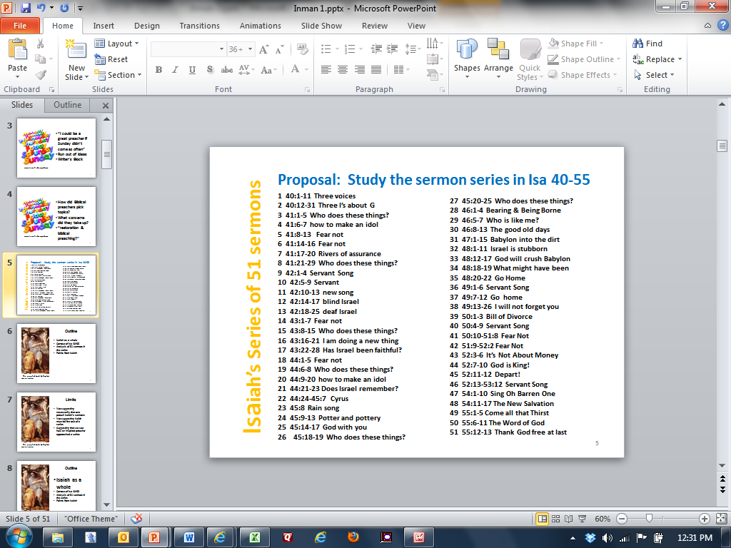
First Glance
51 pericopes, 51 Sundays, 1 week vacation
Long Series
Never announced series
Much repetition
Development of themes
Addresses contemporary issues
Parallels between his world & ours

Slide 8
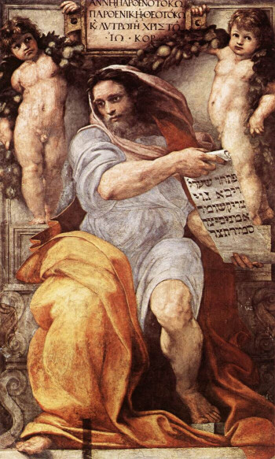
Outline
Isaiah as a whole
World of Isa 40-55
Analysis of 51 sermons in the series
Points from Isaiah
The prophet Isaiah by Raphael
www.finearttouch.com

Slide 9
Limits
Not suggesting necessarily that one preach Isaiah’s sermons
Not suggesting Isaiah must be the text of a series
Suggesting that we see how an inspired preacher approached a series
The prophet Isaiah by Raphael
www.finearttouch.com

Slide 10
Outline
Isaiah as a whole
Context of Isa 40-55
Analysis of 51 sermons in the series
Points from Isaiah
The prophet Isaiah by Raphael
www.finearttouch.com

Slide 11
Outline of all Isaiah
1-12 Oppression/judgment/hope
13-23 Oracles against the nations
24-27 World apocalyptic
28-33 Woes (6)
34-35 Herem/Homecoming
36-39 Hezekiah
40-55 God of hope & history sends a servant
56-66 God high & holy sends a preacher

Slide 12
Isaiah writes
to three different audiences
  1-39—8th century B.C. Jerusalem
  40-55—6th century B.C.
    People from Jerusalem in Babylonian Captivity
    Controversy over divisions of text
  56-66—5th century B.C.
    post-exilic Jerusalem

Slide 13
Foundational Teachings in Isaiah
  Messiah
  Nature of God
  Service
  Nature of Justice
  Word of God
  New heavens and the new earth

Slide 14
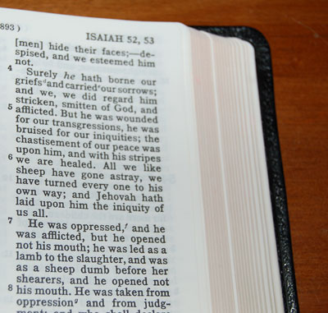
Familiar Texts in Isa 40-55
The prophet Isaiah by Raphael along side the suffering servant passage.
www.finearttouch.com

Slide 15
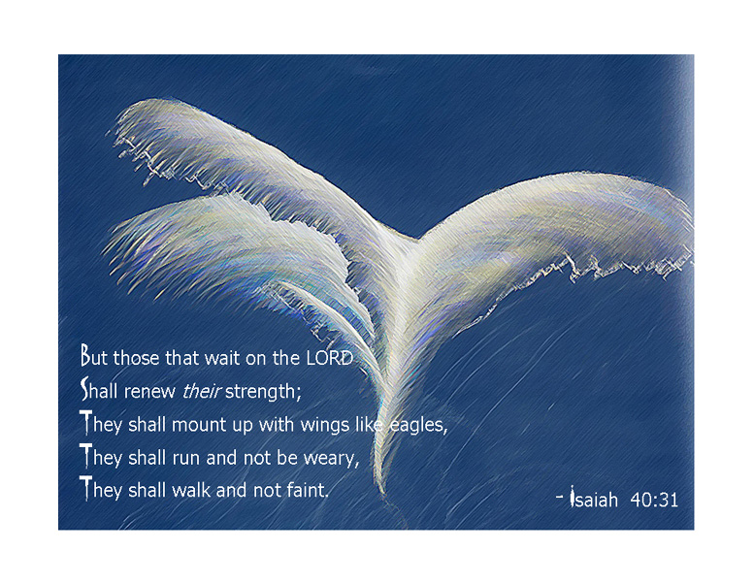

Slide 16

41:10 fear not, for I am with you, be not dismayed, for I am your God; I will strengthen you, I will help you, I will uphold you with my victorious right hand.
i27.photobucket.com

Slide 17

49:6 I will give you as a light to the nations, that my salvation may reach to the end of the earth.
library.thinkquest.org/.../other/light.jpg

Slide 18

http://thecoolsun.blogspot.com
49:15 "Can a woman forget her sucking child, that she should have no compassion on the son of her womb? Even these may forget, yet I will not forget you.

Slide 19
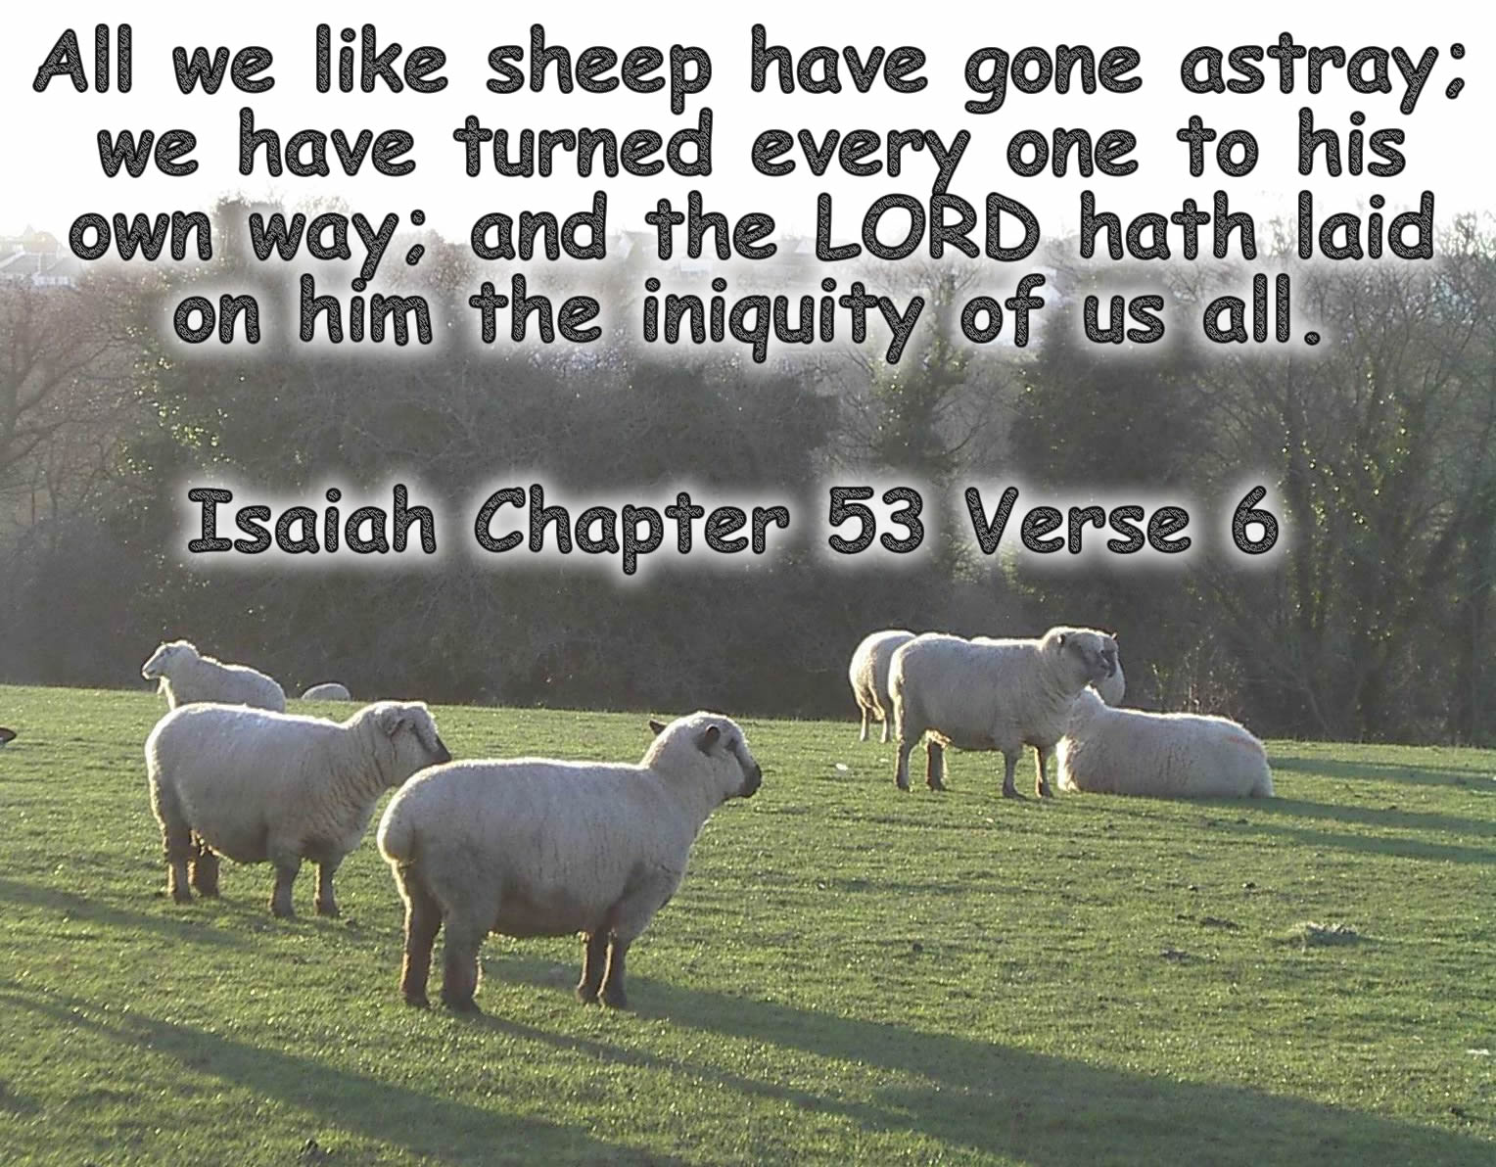

Slide 20
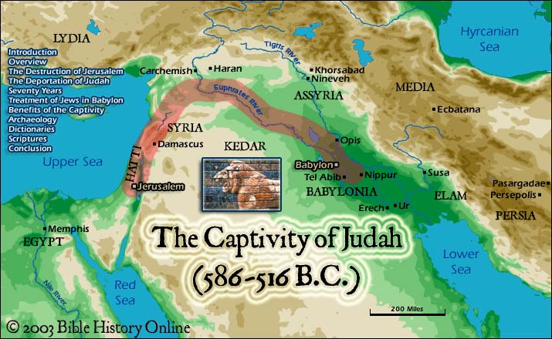
http://www.bible-history.com

Slide 21
Outline
Isaiah as a whole
World of Isa 40-55
Analysis of 51 sermons in the series
Points from Isaiah
The prophet Isaiah by Raphael
www.finearttouch.com

Slide 22

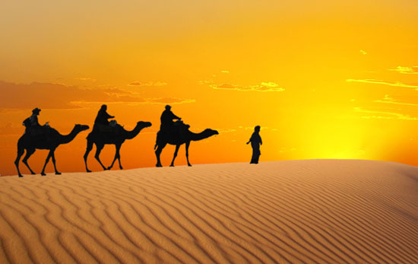
Similarities between Isaiah’s times and our world
www.guardian.co.uk
www.goworldtravel.com

Slide 23

People in exile
mila-loveology.blogspot.com
    41:8-9 But you, Israel, my servant, Jacob, whom I have chosen, the offspring of Abraham, my friend; ⁹ you whom I took from the ends of the earth, and called from its farthest corners, saying to you, "You are my servant, I have chosen you and not cast you off…"
Notes:
Expectation of return
44:26-28--Jerusalem and Judah will be rebuilt
46-47--The LORD carries his people to HIS city.
Zion (46:13)/Babylon (47:1)
LORD (47:4)/Bel & Nebo (46:1)
Exiled Israel returns home (46:13); Exiled Babylon enters captivity (47:2-3)
Babylonian gods are carried off by their people (46:1), the LORD carries his people home (46:3-4)

Slide 24
People in exile
mila-loveology.blogspot.com
    49:21-22 Then you will say in your heart, "Who has borne me these? I was bereaved and barren, exiled and put away-- so who has reared these? I was left all alone-- where then have these come from?" ²² Thus says the Lord GOD: I will soon lift up my hand to the nations, and raise my signal to the peoples; and they shall bring your sons in their bosom, and your daughters shall be carried on their shoulders.
Notes:
Expectation of return
44:26-28--Jerusalem and Judah will be rebuilt
46-47--The LORD carries his people to HIS city.
Zion (46:13)/Babylon (47:1)
LORD (47:4)/Bel & Nebo (46:1)
Exiled Israel returns home (46:13); Exiled Babylon enters captivity (47:2-3)
Babylonian gods are carried off by their people (46:1), the LORD carries his people home (46:3-4)

Slide 25
People in exile
    41:8-9 called from its farthest corners
    49:21-22 I was bereaved & barren, exiled
    Contemporary world
      Homeless, it doesn’t feel like home
      Loss of national identity
      Things are not the way they used to be
mila-loveology.blogspot.com
Notes:
Expectation of return
44:26-28--Jerusalem and Judah will be rebuilt
46-47--The LORD carries his people to HIS city.
Zion (46:13)/Babylon (47:1)
LORD (47:4)/Bel & Nebo (46:1)
Exiled Israel returns home (46:13); Exiled Babylon enters captivity (47:2-3)
Babylonian gods are carried off by their people (46:1), the LORD carries his people home (46:3-4)

Slide 26
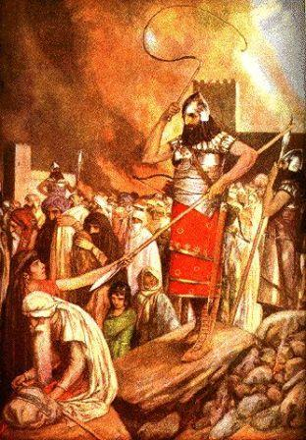
People Afraid
      51:12—who are you that you are afraid of man who dies
      54:11—O afflicted one, storm-tossed & not comforted...
oneyearbibleimages.com

Slide 27
People Afraid
      51:12—afraid of man
      54:11--O afflicted one, storm-tossed & not comforted...
      Contemporary World
        Rapid cultural change prompts fear
        Violence, uncertainty make people afraid
oneyearbibleimages.com

Slide 28
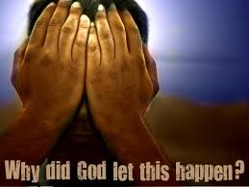
People Questioned God
      40:18—To whom then will you liken God, or what likeness compare with him? 19 The idol! a workman casts it, and a goldsmith overlays it with gold, and casts for it silver chains.
      40:27—Why do you say, O Jacob, & speak O Israel, 'My Way is hid from the LORD, & my right is disregarded by my God?‘
darrellcreswell.wordpress.com
46:12—hearken to me, you stubborn [MT: stubborn; LXX: discouraged] of heart, you who are far from deliverance

Slide 29
People Questioned God
      45:9—Isaiah pictures people as clay pot arguing with its maker. The people were rebuking God!
      49:14—But Zion said, 'The LORD has forsaken me, my Lord has forgotten me.'
darrellcreswell.wordpress.com

Slide 30
People Questioned God
      40:27—My Way is hid from the LORD, & my right is disregarded by my God?
      49:14—The LORD has forsaken me, my Lord has forgotten me.
      Contemporary world
      Militant Atheism
      Decline in belief
      Blaming God
darrellcreswell.wordpress.com

Slide 31
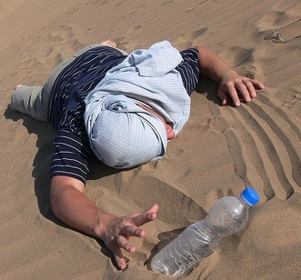
People felt weak & defeated
    41:14—Fear not, you worm Jacob, you men of Israel
    41:17—When the poor and needy seek water, and there is none, and their tongue is parched with thirst, I the LORD will answer them…
www.talentedgeneration.com
44:22—But this is a people robbed and plundered, they are all of them trapped in holes and hidden in prisons. They have become a prey with none to rescue, a spoil with none to say, 'Restore!’

Slide 32
People felt weak & defeated
      41:17—When the poor and needy seek water, and there is none, and their tongue is parched with thirst, I the LORD will answer them..
      42:22—But this is a people robbed & plundered, they are all of them trapped in holes & hidden in prisons. They have become a prey with none to rescue, a spoil with none to say, 'Restore!’
      Contemporary world
      Christian bashing
      Decline in membership
      Youth exodus
www.talentedgeneration.com

Slide 33

Attraction to new culture
46:5 To whom will you liken me and make me equal, and compare me, that we may be alike? 6 Those who lavish gold from the purse, and weigh out silver in the scales, hire a goldsmith, and he makes it into a god; then they fall down and worship! 7 They lift it upon their shoulders, they carry it, they set it in its place, and it stands there; it cannot move from its place. If one cries to it, it does not answer or save him from his trouble. 8 Remember this and consider, recall it to mind, you transgressors, 9 remember the former things of old; for I am God, and there is no other; I am God, and there is none like me…
omtimes.com

Slide 34
Attraction to new culture
46:6 Those who lavish gold from the purse, and weigh out silver in the scales, hire a goldsmith, and he makes it into a god; then they fall down and worship! 9 remember the former things of old; for I am God, and there is no other; I am God, and there is none like me…
Contemporary World
Christians increasingly blend with contemporary culture
Movies, dress, habits
omtimes.com

Slide 35
Two Fundamental Questions of people addressed to God in Isa 40-55
Power
  God lost the last war
  Babylonians rule world
  Temple gone
  State, king, culture—all gone
Interest
  God lost interest in his people
  If God can help, he doesn’t want to
oneyearbibleimages.com
Notes:
Written to exiles who have 2 problems with God
Questioned God’s power to save them
Questioned God’s interest in saving them
Written to give insight into the nature of god
He is powerful enough to save (creator, over idols)
He cares enough to save (redeemer, savior, fear not)
Three things happened to exiles (just like today)
Some assimilated to the culture
Some exhausted themselves with despair
Some recast their faith and found hope
Isaiah’s focus changes
40-47—Isaiah calls the exiles away from idols
48-55—Isaiah calls the exiles away from Babylon
Isaiah’s analysis of the situation
Israel’s greatest enemy was their philosophical and ideological thinking, not their physical enemies
In the midst of despair remember what God has done in the past.
Isaiah’s solution: Word of God
40:8 ⁸ The grass withers, the flower fades; but the word of our God will stand forever.
55:11 ¹¹ so shall my word be that goes out from my mouth; it shall not return to me empty, but it shall accomplish that which I purpose, and succeed in the thing for which I sent it.
Believe in God [not idols] because he is God of history and hope
Do Not be afraid

Slide 36
Fundamental Questions of people in Isa 40-55
Exiles’ Questions about God
  Power
  Interest
Isaiah Gives Two Responses
  40:10-11 Behold, the Lord GOD comes with might, and his arm rules for him; behold, his reward is with him, and his recompense before him. 11 He will feed his flock like a shepherd, he will gather the lambs in his arms, he will carry them in his bosom, and gently lead those that are with young.
oneyearbibleimages.com
Notes:
Written to exiles who have 2 problems with God
Questioned God’s power to save them
Questioned God’s interest in saving them
Written to give insight into the nature of god
He is powerful enough to save (creator, over idols)
He cares enough to save (redeemer, savior, fear not)
Three things happened to exiles (just like today)
Some assimilated to the culture
Some exhausted themselves with despair
Some recast their faith and found hope
Isaiah’s focus changes
40-47—Isaiah calls the exiles away from idols
48-55—Isaiah calls the exiles away from Babylon
Isaiah’s analysis of the situation
Israel’s greatest enemy was their philosophical and ideological thinking, not their physical enemies
In the midst of despair remember what God has done in the past.
Isaiah’s solution: Word of God
40:8 ⁸ The grass withers, the flower fades; but the word of our God will stand forever.
55:11 ¹¹ so shall my word be that goes out from my mouth; it shall not return to me empty, but it shall accomplish that which I purpose, and succeed in the thing for which I sent it.
Believe in God [not idols] because he is God of history and hope
Do Not be afraid

Slide 37
3 Exile Experiences
Assimilation
  Become part of culture
  Become Babylonians
Exhaustion
  Give up
  Live in past hope
Recast faith
  Zion
oneyearbibleimages.com
Notes:
Written to exiles who have 2 problems with God
Questioned God’s power to save them
Questioned God’s interest in saving them
Written to give insight into the nature of god
He is powerful enough to save (creator, over idols)
He cares enough to save (redeemer, savior, fear not)
Three things happened to exiles (just like today)
Some assimilated to the culture—could not tell difference between G’s people and B
Some exhausted themselves with despair—depressed, want to give up, looking for hope
Some recast their faith and found hope
Isaiah’s focus changes
40-47—Isaiah calls the exiles away from idols
48-55—Isaiah calls the exiles away from Babylon
Isaiah’s analysis of the situation
Israel’s greatest enemy was their philosophical and ideological thinking, not their physical enemies
In the midst of despair remember what God has done in the past.
Isaiah’s solution: Word of God
40:8 ⁸ The grass withers, the flower fades; but the word of our God will stand forever.
55:11 ¹¹ so shall my word be that goes out from my mouth; it shall not return to me empty, but it shall accomplish that which I purpose, and succeed in the thing for which I sent it.
Believe in God [not idols] because he is God of history and hope
Do Not be afraid

Slide 38
3 Contemporary Experiences
Assimilation
  Become part of culture
  Culture over Scripture
Exhaustion
  Give up
  Live in past hope
Recast faith
oneyearbibleimages.com
Notes:
Written to exiles who have 2 problems with God
Questioned God’s power to save them
Questioned God’s interest in saving them
Written to give insight into the nature of god
He is powerful enough to save (creator, over idols)
He cares enough to save (redeemer, savior, fear not)
Three things happened to exiles (just like today)
Some assimilated to the culture—could not tell difference between G’s people and B
Some exhausted themselves with despair—depressed, want to give up, looking for hope
Some recast their faith and found hope
Isaiah’s focus changes
40-47—Isaiah calls the exiles away from idols
48-55—Isaiah calls the exiles away from Babylon
Isaiah’s analysis of the situation
Israel’s greatest enemy was their philosophical and ideological thinking, not their physical enemies
In the midst of despair remember what God has done in the past.
Isaiah’s solution: Word of God
40:8 ⁸ The grass withers, the flower fades; but the word of our God will stand forever.
55:11 ¹¹ so shall my word be that goes out from my mouth; it shall not return to me empty, but it shall accomplish that which I purpose, and succeed in the thing for which I sent it.
Believe in God [not idols] because he is God of history and hope
Do Not be afraid

Slide 39
Isaiah’s two fold focus
Exiles
  40-46—Idols out of exiles
  47-55—exiles out of Babylon
Servant
  42-53—all Israel as servant to servants in Israel
  49-55—servant leader in Israel leads resistant Zion home
oneyearbibleimages.com
Notes:
Written to exiles who have 2 problems with God
Questioned God’s power to save them
Questioned God’s interest in saving them
Written to give insight into the nature of god
He is powerful enough to save (creator, over idols)
He cares enough to save (redeemer, savior, fear not)
Three things happened to exiles (just like today)
Some assimilated to the culture—could not tell difference between G’s people and B
Some exhausted themselves with despair—depressed, want to give up, looking for hope
Some recast their faith and found hope
Isaiah’s focus changes
40-47—Isaiah calls the exiles away from idols
48-55—Isaiah calls the exiles away from Babylon
Isaiah’s analysis of the situation
Israel’s greatest enemy was their philosophical and ideological thinking, not their physical enemies
In the midst of despair remember what God has done in the past.
Isaiah’s solution: Word of God
40:8 ⁸ The grass withers, the flower fades; but the word of our God will stand forever.
55:11 ¹¹ so shall my word be that goes out from my mouth; it shall not return to me empty, but it shall accomplish that which I purpose, and succeed in the thing for which I sent it.
Believe in God [not idols] because he is God of history and hope
Do Not be afraid

Slide 40
Parallels between Isaiah & our world
Being faithful in a changing world
Reasons to believe in God in a world that challenges that belief
Dependability of Word of God
Power of God v the power of the state
oneyearbibleimages.com
Notes:
Written to exiles who have 2 problems with God
Questioned God’s power to save them
Questioned God’s interest in saving them
Written to give insight into the nature of god
He is powerful enough to save (creator, over idols)
He cares enough to save (redeemer, savior, fear not)
Three things happened to exiles (just like today)
Some assimilated to the culture—could not tell difference between G’s people and B
Some exhausted themselves with despair—depressed, want to give up, looking for hope
Some recast their faith and found hope
Isaiah’s focus changes
40-47—Isaiah calls the exiles away from idols
48-55—Isaiah calls the exiles away from Babylon
Isaiah’s analysis of the situation
Israel’s greatest enemy was their philosophical and ideological thinking, not their physical enemies
In the midst of despair remember what God has done in the past.
Isaiah’s solution: Word of God
40:8 ⁸ The grass withers, the flower fades; but the word of our God will stand forever.
55:11 ¹¹ so shall my word be that goes out from my mouth; it shall not return to me empty, but it shall accomplish that which I purpose, and succeed in the thing for which I sent it.
Believe in God [not idols] because he is God of history and hope
Do Not be afraid

Slide 41
Core Problem in Isa 40-55
Babylon’s culture & might
  Exile perspective
Israel’s spiritual condition
  God’s perspective
oneyearbibleimages.com
Notes:
Written to exiles who have 2 problems with God
Questioned God’s power to save them
Questioned God’s interest in saving them
Written to give insight into the nature of god
He is powerful enough to save (creator, over idols)
He cares enough to save (redeemer, savior, fear not)
Three things happened to exiles (just like today)
Some assimilated to the culture
Some exhausted themselves with despair
Some recast their faith and found hope
Isaiah’s focus changes
40-47—Isaiah calls the exiles away from idols
48-55—Isaiah calls the exiles away from Babylon
Isaiah’s analysis of the situation
Israel’s greatest enemy was their philosophical and ideological thinking, not their physical enemies
In the midst of despair remember what God has done in the past.
Isaiah’s solution: Word of God
40:8 ⁸ The grass withers, the flower fades; but the word of our God will stand forever.
55:11 ¹¹ so shall my word be that goes out from my mouth; it shall not return to me empty, but it shall accomplish that which I purpose, and succeed in the thing for which I sent it.
Believe in God [not idols] because he is God of history and hope
Do Not be afraid
STRESS:
1. Role Servant had as a voice for God (49:1f; 50)

Slide 42
Core Problem
  Babylon’s culture & might
  Israel’s spiritual condition
Core Solution
  40:8 The grass withers, the flower fades; but the word of our God will stand for ever.
  55:11 so shall my word be that goes forth from my mouth; it shall not return to me empty, but it shall accomplish that which I purpose, and prosper in the thing for which I sent it.
oneyearbibleimages.com
Notes:
Written to exiles who have 2 problems with God
Questioned God’s power to save them
Questioned God’s interest in saving them
Written to give insight into the nature of god
He is powerful enough to save (creator, over idols)
He cares enough to save (redeemer, savior, fear not)
Three things happened to exiles (just like today)
Some assimilated to the culture
Some exhausted themselves with despair
Some recast their faith and found hope
Isaiah’s focus changes
40-47—Isaiah calls the exiles away from idols
48-55—Isaiah calls the exiles away from Babylon
Isaiah’s analysis of the situation
Israel’s greatest enemy was their philosophical and ideological thinking, not their physical enemies
In the midst of despair remember what God has done in the past.
Isaiah’s solution: Word of God
40:8 ⁸ The grass withers, the flower fades; but the word of our God will stand forever.
55:11 ¹¹ so shall my word be that goes out from my mouth; it shall not return to me empty, but it shall accomplish that which I purpose, and succeed in the thing for which I sent it.
Believe in God [not idols] because he is God of history and hope
Do Not be afraid
STRESS:
1. Role Servant had as a voice for God (49:1f; 50)

Slide 43
Outline
Isaiah as a whole
World of Isa 40-55
Analysis of 51 sermons in the series
Points from Isaiah
The prophet Isaiah by Raphael
www.finearttouch.com

Slide 44
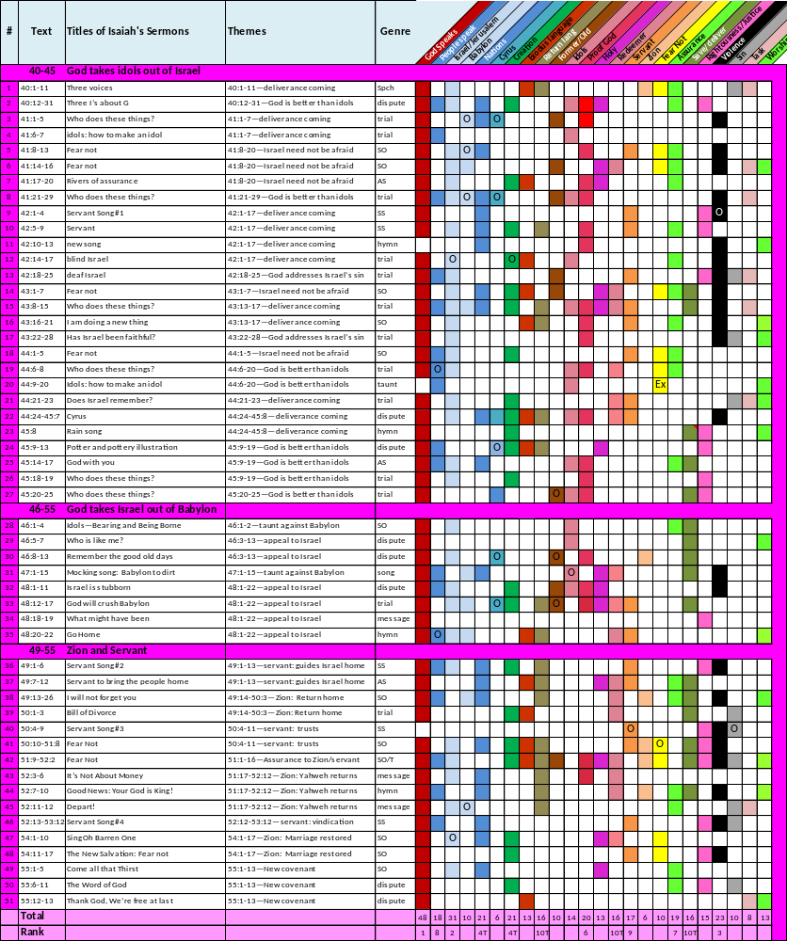
Text
Titles of Isaiah's Sermons
Themes
Genre
Marks
of text

Slide 45
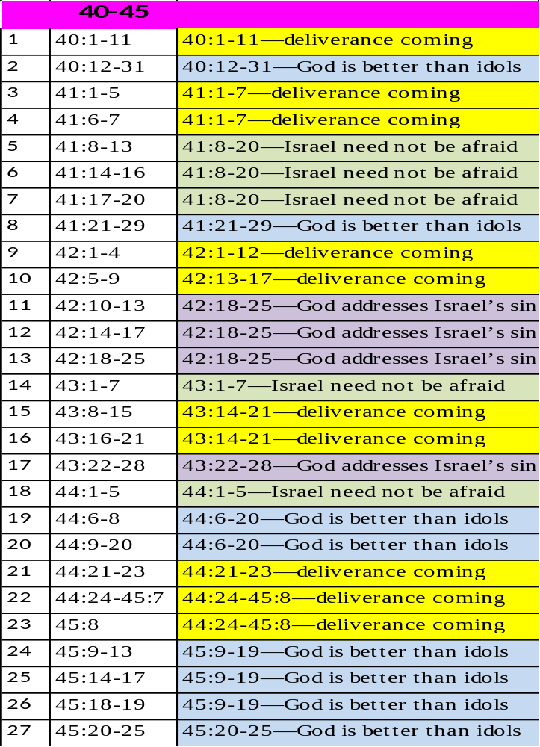
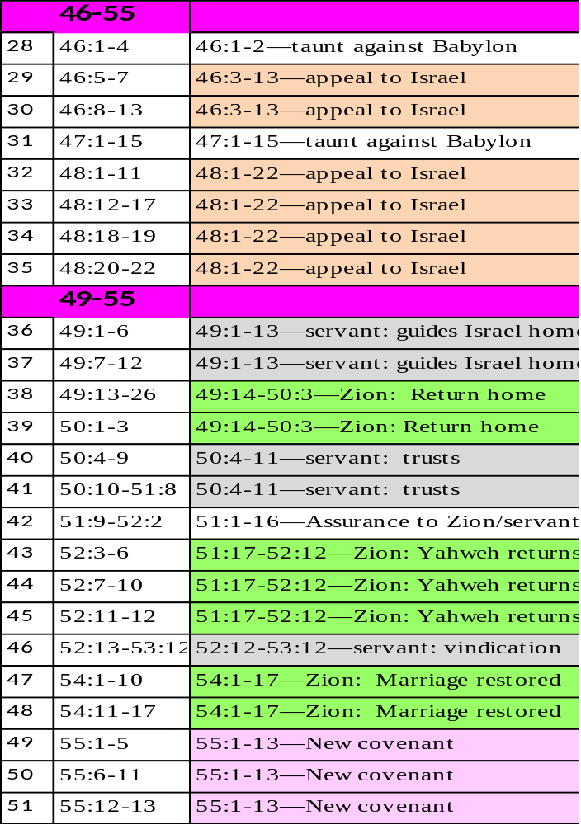

Slide 46
Theme | Sermons
Deliverance | 10
No fear | 5
Idols | 7
Sin | 4
Prophet
  Addresses issues
  Offers hope
  Challenges
  Repeats

Slide 47
Theme | Sermons
Appeal | 6
Servant | 5
Zion go home | 7
Taunt | 2
New covenant | 3
Prophet
Adjusts series
Taunts
Calls for verdict
Motivates
Other Observations?

Slide 48
Outline
Isaiah as a whole
World of Isa 40-55
Analysis of 51 sermons in the series
Points from Isaiah
The prophet Isaiah by Raphael
www.finearttouch.com

Slide 49
Preaching—What to Preach?
Sunday Comes Every Seven Days
Inman 1
www.learnhebrewpod.com

